Slide 1
University of Louisville School of Medicine
Strategic Planning Initiative
Clinical Enterprise Team
Draft Findings and Recommendations

Slide 2
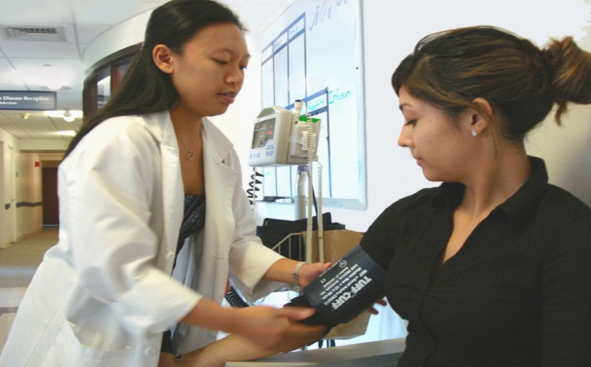
The Clinical Enterprise Committee Members
Greg Postel - Chair
Russell Bessette
Daniel Danzl
Kelli Dunn
Renee Girdler
Vandra Harris
Jerry Johnson
Darryl Kaelin
Kristine Kreuger
Sara Petruska
Mark Pfeifer
Elizabeth Riley
John Roberts
Jason Smith
Brad Sutton
Excelcor Team Members
Jennifer Donnelly
Christopher Nickson
Scott Nostaja

Slide 3
Background and Context
The Committee’s Work
The Clinical Enterprise Committee examined the strengths, weaknesses, opportunities and threats (SWOTs) facing the University of Louisville’s primary clinical practice areas, in an effort to answer the question, “Where are we today?”
The Committee members were assigned individual practice areas, and presented a SWOT analysis for each to the group. See Appendices A and B.
From these presentations, a robust discussion ensued regarding the SWOTs of each practice area, as well as the implications outside of an individual practice area.
Common themes were identified that cut across nearly all of these practice areas.
These themes generally revealed both a compelling strength of the physicians at UofL, as well as significant opportunities for growth or improvement.

Slide 4
Findings and Observations
The University of Louisville Physician Brand and Image
One of the great strengths of the physicians of the University of Louisville is that they offer great diversity and uniqueness in their clinical practices.
This diversity and uniqueness in clinical practice area strengths is highlighted in the attached Appendix C.
However, the strengths associated with this diversity and uniqueness have led to a “brand” issue for UofL physicians.
Most physician services are known or marketed within their own hospitals, due to the competitive nature of the local hospital systems.
Less emphasis tends to be placed on the UofL brand, but instead is placed on (for example) the “Frazier Rehab Institute” or the “Brown Cancer Center.”
The result is that there is a perception that UofL physicians have, in some instances, become faceless providers within a well-known system, institute or center.

Slide 5
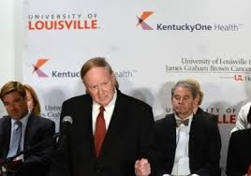
Recommendations
The University of Louisville Physician Brand and Image
Engage in a targeted media campaign that specifically highlights UofL physicians.
Consider co-branding techniques that capitalize on the strengths of existing, well-known local brands. For example, a television commercial featuring the following message:
I am a physician at Louisville’s Brown Cancer Center.
I am a physician at Louisville’s Frazier Rehab Institute.
We are University of Louisville physicians.
Consider co-marketing with Kentucky One, emphasizing the partnership with University of Louisville Physicians.

Slide 6
Recommendations
The University of Louisville Physician Brand and Image
Develop single-page “Meet Your Doctor” handout or e-mail for every UofL physician to provide to patients in their examination or hospital rooms.
The handout would provide a basic CV, outlining a physician’s educational and work experience.
The handout (an example offered at right) would also provide a basis for patients to recommend their physician to others, increasing potential referral sources.

Slide 7
Recommendations
The University of Louisville Physician Brand and Image
Develop future areas of strategic clinical focus with each of UofL’s major partners, including taking the following steps:
Maximize our opportunities with our new partner, Kentucky One.
Promote mutually beneficial relationships with our hospital partners, including strengthening our relationship with the VA and stabilizing our outside network hospital practice relationships.

Slide 8
Findings and Observations
Referral of Patients within Network of University of Louisville Physicians
Due to the diversity and uniqueness of physician services, the physicians of the University of Louisville provide an excellent network of potential referrals.
Recognizing this strength in the breadth of services offered, the physicians of the University of Louisville created an organization (ULP) intended to provided a united front among physician faculty members, as well as to reduce costs through economies of scale and enhance care coordination, and thereby improve the patient experience.
The creation of this organization required a significant investment of resources from both the University and the physicians themselves.
This investment contemplates that growth in clinical services will be achieved through increased referrals from one UofL physician to another.

Slide 9
Findings and Observations
Referral of Patients within Network of University of Louisville Physicians (con’t)
While the clinical practices would generally like to offer a united front and refer patients within the UofL network, some practice groups have been forced to seek other (non-UofL) partners to remain financially viable.
This failure to refer to other UofL physicians stems from a host of reasons, including:
Delays in the length of time for patients to get an appointment, based on the failure of some physicians to hold appointment openings for potential referral patients;
These delays are caused, in part, by physician recruitment needs and opportunities to improve scheduling processes.
The inability to determine which physicians are University of Louisville physicians, based on individual practice group names that often do not refer to UofL.

Slide 10
Findings and Observations
Referral of Patients within Network of University of Louisville Physicians (con’t)
This failure to refer to other UofL physicians stems from a host of reasons, including (con’t):
Traditional and culturally ingrained physician referral patterns that do not include consideration (at least in the first instance) of UofL physicians;
For example, the bulk of primary care physicians in the Louisville area are employed by (and many specialists supported by) competing networks, with loyalties running with funding sources, instead of with the institution.
The committee recognizes that some of these patterns are changing, but progress has been slow.
Barriers to communication, including inadequate contact information available from the University of Louisville Hospital telephone operators and the lack of updated / appropriate contact information in the physician directory (such as current e-mails and cell phone numbers).

Slide 11
Recommendations
Referral of Patients within Network of University of Louisville Physicians
Create a referral process for each practice area or department that provides priority scheduling and timely access to other UofL physicians seeking to refer patients.
The referral process should be tailored by each practice area or group to reflect their unique workforce capabilities.
With the referral process will come an expectation of enhanced opportunities to refer patients within the UofL physician network, with metrics applicable to each specific practice area or department and incented by the Dean of the School of Medicine.
The process should also make expedited referral appointments available to referring physicians on a 1st available basis, and require consults be seen within 24 hours.
Update the University of Louisville Physician directory, and study the most effective distribution method of the directory to all UofL physicians.
The Committee has considered making the directory available either on-line or hard copy, to list pager numbers or cell phone numbers of physicians and potentially organizing the directory by practice group rather than by physician name.

Slide 12
Recommendations
Referral of Patients within Network of University of Louisville Physicians
Create and fund a centralized point of contact through ULP for UofL physicians to communicate to one another for referral purposes.
Invest in dedicated live operators, trained in making referrals within UofL’s network.
The existing ULP website provides physician resources that could be further developed to provide greater access to referral physicians.
Provide greater opportunities for attending physicians and specialists to meet one another and develop natural referral networks.
Explore all permissible mechanisms to encourage UofL physicians to refer patients to other UofL physicians, including incentives for an attending physician to see every hospitalized patient every day.
Develop greater capabilities for chronic disease management and preventative medicine, especially in a climate of health care reform.
Consider offering “concierge” services for executives of large, local corporations, such as YUM and UPS.

Slide 13
Findings and Observations
The Primary Care Physician Workforce
A desperate need exits within both the Commonwealth of Kentucky and nationally to develop the primary care workforce.
One of the causes for this shortfall among primary care physicians is the impact of medical school student debt and the choices new physicians must make to retire this debt.
Another cause of the primary care physician shortfall is the misperception that an investment in the primary care work force does not produce downstream revenues.
Many institutions have also failed to develop sufficient work satisfaction models for their primary care workforce, leading to a lack of interest initially or resulting in subsequent departures among primary care physicians in favor of specialties.

Slide 14
Findings and Observations
The Primary Care Physician Workforce (con’t)
UofL does an excellent job training the physician workforce of the future, but the debt burden is significant.
The debt load carried by UofL medical school students is less than the national average, but still presents significant barriers to students upon graduation.
This debt burden affects the choices UofL-trained physicians make in deciding on the location of their practices and the specialties they select.
Unfortunately, many university programs (outside of UofL) that offer to pay down a student’s debt likely do not provide a financially sustainable model for UofL.

Slide 15
Recommendations
The Primary Care Physician Workforce
Develop models that incentivize future physicians to accept employment in rural and underserved areas, as well as taking up specialties of critical need, such as primary care.
Physicians trained in rural and underserved areas are more likely to practice in those areas following their training, which supports a greater investment in primary care education sites in these areas.
Consider approaches that more directly increase compensation for physicians in underserved geographical locations and specialties.
Enhance career satisfaction for primary care physicians that provide a steady practice (not chaos), collegiality, and a work environment with sufficient support systems.
Invest in additional primary care physicians beyond the current FTE projections, recognizing the downstream benefits such an investment will provide.

Slide 16
Findings and Observations
Physician Compensation Models
The University of Louisville has historically provided significant autonomy to individual departments to set the terms of compensation for physicians.
The consequence of this approach is that the University lacks a unified compensation model for faculty members.
The lack of a unified model has presented hurdles in developing an environment that is more incentive-driven, based on various productivity measures.
The committee recognizes that purely focusing on clinical productivity measures has the potential cost or risk of reducing quality of care.
Therefore, any productivity measures must be balanced with equally compelling quality metrics and reflect the academic mission of the department and institution.

Slide 17
Recommendations
Physician Compensation Models
Develop productivity and quality measures that provide incentives to physicians to increase revenue while retaining quality and academic focus.
The committee believes that a physician’s salary should be tied to the institution’s goals and mission, such as clinical care (including indigent care), teaching and research.
The committee also recognizes that existing contracts may make it more difficult to link compensation to certain metrics; however, for some faculty (especially term faculty), an opportunity exists to develop such a model.
Departments chairs could be linked with economics faculty in the UofL School of Business to develop compensation models.
These measures must also recognize and be responsive to the impact the Affordable Care Act will have on physician practices.

Slide 18
Findings and Observations
Clinical Trials
UofL offer excellent translational and clinical trial opportunities, given the breadth of its clinical practices and the research experience of its faculty.
The Kentucky One Partnership provides UofL with the potential to orchestrate clinical trials throughout the Kentucky One and CHI networks.
These opportunities have the potential to flow in both directions, with research emanating from UofL, as well as research opportunities developed elsewhere to become opportunities at UofL.
Nevertheless, there are serious questions about UofL’s capabilities to conduct such trials effectively, given that clinical trial enrollment is in significant decline and the underlying research infrastructure is underperforming.

Slide 19
Recommendations
Clinical Trials
Commit greater resources to UofL’s clinical trial and research infrastructures that support principal investigators, especially within UofL’s Office of Industry Contracts.
Centralize clinical trial support into a single, University-wide office.
The committee recognizes that many groups, such as the Brown Cancer Center and the Department of Pediatrics, have strong clinical trial support groups, and could serve as models for this new clinical trial support office.
If sufficient investments and capable human resources are devoted to such a central office, the committee believes that early successes with this group will incentivize others to join.
Develop greater accountability measures at the highest levels of the University to ensure clinical trial research is given adequate priority.

