Slide 1
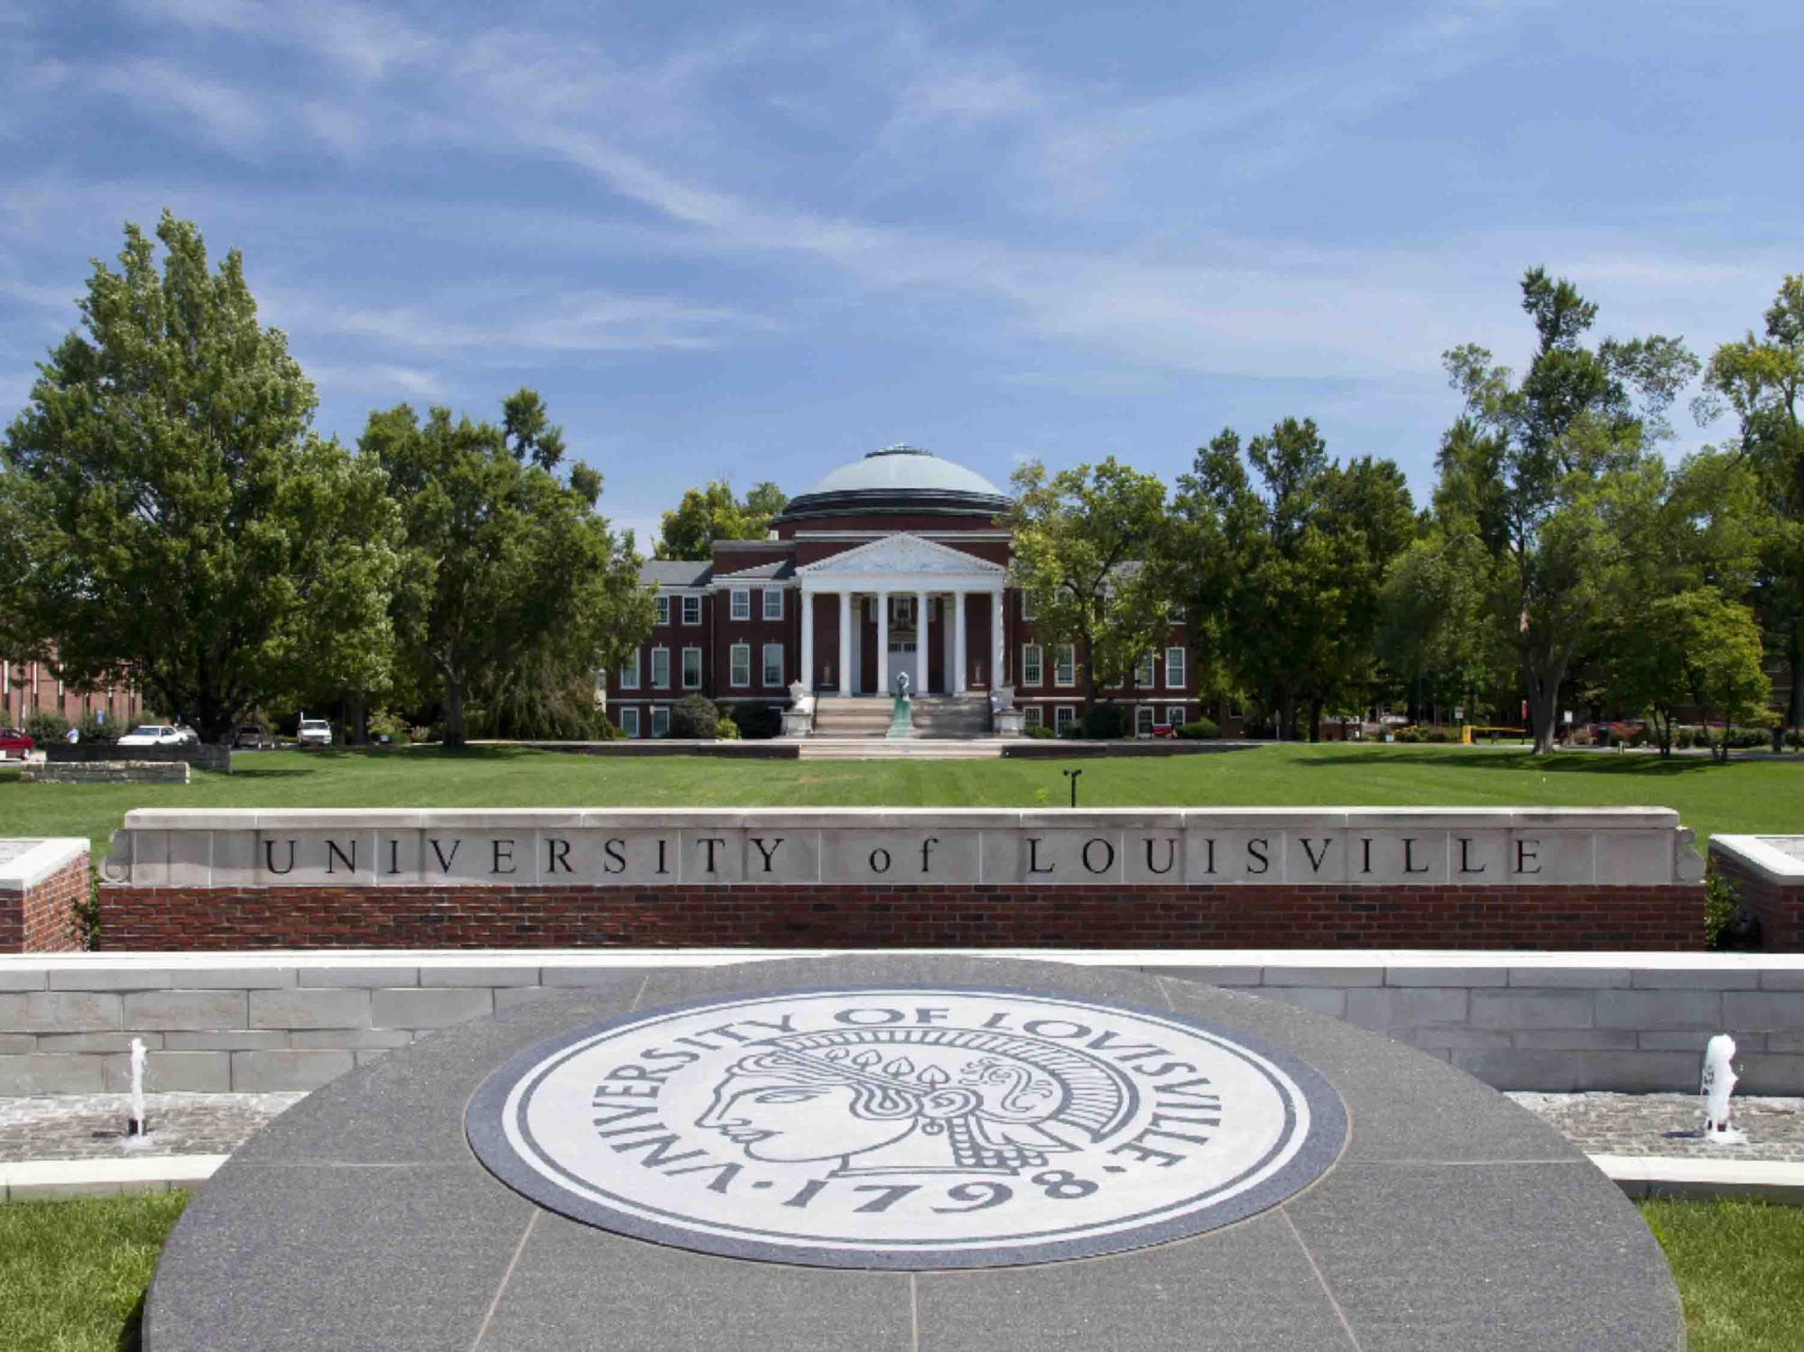
School of Medicine Strategic Planning
Community Engagement Committee
August 2013

Slide 2
The Community Engagement Committee
Sharmila Makhija - Chair
Dan Cogan
Kelli Bullard Dunn
Irv Joshua
Faye Jones
Erica Labar
Gary Mans
Terri Mason
Kerri Remmel
Michael Rowland
Ted Smith
Allan Tasman
Steve Wheeler

Slide 3
School of Medicine
The Community Engagement Team was assembled as one of four strategic planning teams charged with developing a path forward for the School of Medicine to define and advance its role in the community
Educational Enterprise
Committee
A plan for enhancing the quality and breadth of the medical education and student success
Planning Process that is Inclusive, Collaborative, Transparent
Research
Enterprise
Committee
A plan for growing and strengthening our research portfolio
Four Inter-related and Integrated Planning Initiatives
Seek input and participation from all critical stakeholder`s including faculty, staff, ULP, University Hospital, and Kentucky One
Clinical
Enterprise Committee
A plan for improving the quality and strength of our clinical practice
Community
Engagement Committee
A plan for enhancing our impact and role in the community

Slide 4
The Committee followed the general approach used by each of the four strategic planning teams and completed Phases 1 & 2
Where are we today?
Where do we want to be?
How will we get there?
Assessment of existing community practices
Evaluation of strengths, weaknesses, opportunities, and threats
The design of plans to improve the quality of community practices, programs and efforts
Detailed plans for implementing initiatives designed to improve educational, clinical, research and community programs , practices and services

Slide 5
Where are we today?
Creating a common definition of Community Engagement to guide the effort
To guide its effort, the Committee created the following definition of "Community Engagement"
Community Engagement is a form of scholarship that embraces teaching, research, and service for the mutual benefit of external audiences and the University. Examples could include community-based research, service-learning, educational enrichment programs for the public, youth services, public health outreach, health education, etc.
“Community Engagement” differs from “Community Service”
Community Service is often associated with volunteerism and generally refers to service that a person performs for the benefit of his or her local community.
Community Engagement is a form of scholarship for the mutual benefit of the institution and the community
The Committee recognized that “Community” reaches beyond just the local or regional geography and includes issues of national and global importance

Slide 6
Where are we today?
In assessing and evaluating the current community engagement effort within the School of Medicine, the committee made the following six leading conclusions
Medical School faculty, students and staff are engaged in meaningful scholarly, research, and service projects and initiatives across our major communities (Metro Louisville, Kentuckiana, and the Commonwealth of Kentucky)
There is a lot of good work occurring and people are engaged
While good and meaningful community engagement is occurring, the School’s efforts are largely disjointed and uncoordinated
The School is not leveraging activities, partners or efforts in ways that could produce greater results
The focus of the School’s Community engagement effort is largely led by individual faculty, staff or students
Individuals seek opportunities and develop opportunities aligned to their interests and competencies

Slide 7
Where are we today?
In assessing and evaluating the current community engagement effort within the School of Medicine, the committee made the following six leading conclusions
The School’s Community engagement effort lacks strategic focus and direction
The School lacks a clear vision for its role in the community and any meaningful strategies aligned to such a vision
As a result the School lacks clearly defined objectives, measures, metrics or targets for guiding its Community engagement effort
The School is not getting appropriate recognition from the Community for its efforts
Many efforts are unknown and not widely communicated or shared with others in the School or outside the University
There are limited incentives and rewards for faculty and staff to be involved in community engagement efforts
Promotion and tenure guidelines do not adequately recognize engagement
There are ineffective financial or other rewards to stimulate greater participation in community engagement

Slide 8
Where do we want to be?
In response to the six key findings and conclusions, the Committee developed the following strategies for moving the effort forward
Expand the School’s mission to include “Community Engagement” as a fourth pillar of the School’s goals
Create a vision for Community Engagement
Develop a detailed strategy for achieving the vision
Create specific goals, objectives, targets and measures of success for the School, departments, faculty and staff
Ensure that the Community Engagement Plan in aligned, integrated and supportive of the overall strategic aims of the School of Medicine and with the broader aims of the University and the other Health Sciences Schools

Slide 9
Where do we want to be?
In response to the six key findings and conclusions, the Committee developed the following strategies for moving the effort forward
Create an Office of Community Engagement
Facilitate the development and execution of a Community Engagement Plan that includes, but is not limited to, achieving the following objectives:
Advance scholarly and research based engagement
Broaden community partnerships
Adequately market and promote the effort
Create meaningful rewards and recognition for faculty and staff
Ensure that the overall effort is organized and coordinated
Develop effective and efficient ways to collect information about current and future initiatives and projects
Allocate sufficient resources to facilitate success
Ensure that the office is aligned to the objectives of all units within the School of Medicine and with the broader goals of the University
Ensure Office of Community Engagement is aligned with the mission of the Office of Diversity and Inclusion

Slide 10
Where do we want to be?
In response to the six key findings and conclusions, the Committee developed the following strategies for moving the effort forward
Develop appropriate and effective incentives, rewards and recognition for faculty, staff and students including promotion and tenure policies and practices
Align to current campus initiatives aimed at evolving the role of “Engagement” and evolving rewards and recognition policies
Further investigate internal and external best practices (for example Kent School of Social Work and Michigan State University among others)
Further assess and understand the needs of the Community and align those needs to the School’s strengths, competencies and strategic objectives
Regularly meet with community leaders
Understand leading medical trends and statistics in the communities of interest

Slide 11
Where do we want to be?
In response to the six key findings and conclusions, the Committee developed the following strategies for moving the effort forward
Create a comprehensive marketing and communications plan
Ensure that appropriate resources are committed to fully communicate, market, promote and share the results of the School’s role and work in the community

